Slide 1
SIT202 Computer Networks
Session 6. Routing Protocols and IPv6

Slide 2
Outline
Chapter 20. Unicast Routing
Introduction
Routing Algorithms
Unicast Routing Protocols
Chapter 22. Next Generation IP
IPv6 Addressing
The IPv6 Protocol
The ICMPv6 Protocol
Transition from IPv4 to IPv6

Slide 3
Chapter 20
Unicast Routing

Slide 4
Introduction
Routers are responsible for delivering packets to their destination
The router does this by following the rules in its forwarding table
So how are the forwarding tables built?
Simplistically, routers communicate with each other to determine the paths to different networks
The forwarding table is constructed based on this information
The reality is somewhat more complex, network administrators configure
Each connection a router has to a network
The routing protocol and the scope of that protocol (what networks should be considered)
More advanced rules, e.g., backup routes, routing filters (selective routing), etc.
Once configured correctly however, the network can effectively “run itself”

Slide 5
Introduction
Two main routing algorithms
Distance vector routing
Link-state routing

Slide 6
Introduction-Distance vector routing
Start by representing the network as a weighted graph
Each node represents a router
Each edge represents a link between the routers
Each edge is weighted according to the “cost” of the link
The “best route” represents the path with the lowest total cost
Each router can then determine the best route to each destination by selecting the path with the least cost
This can be represented as a tree (a least-cost tree)

Slide 7
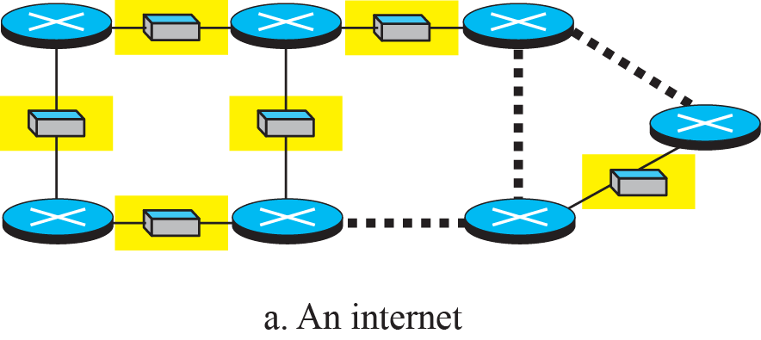
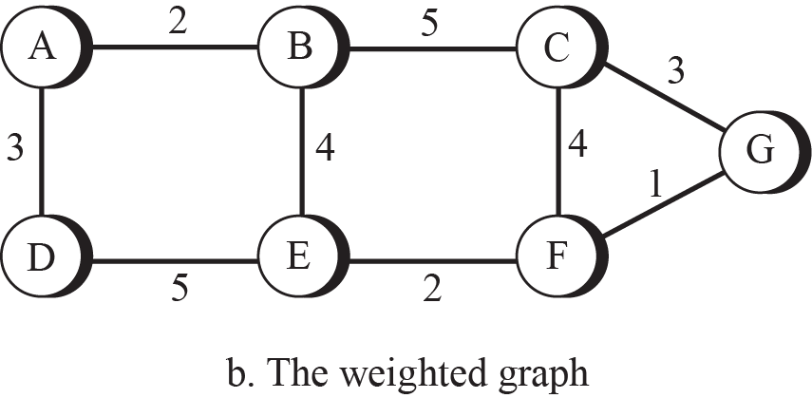
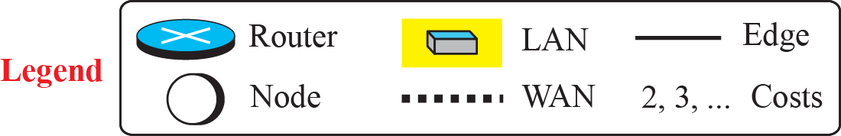
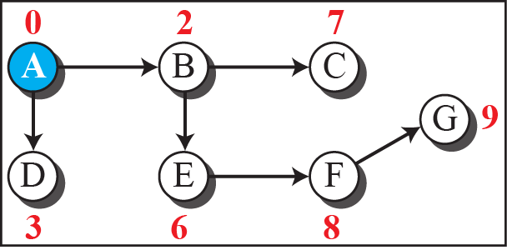
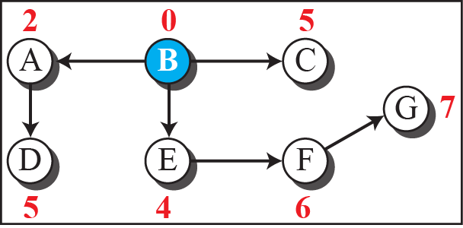
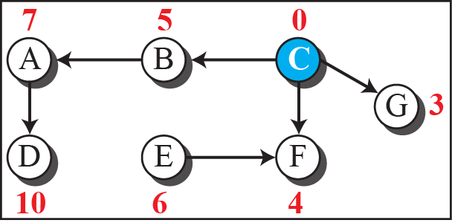
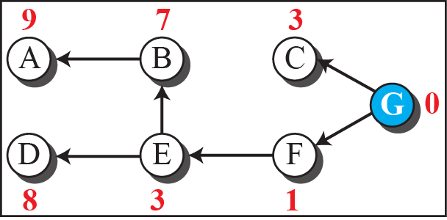
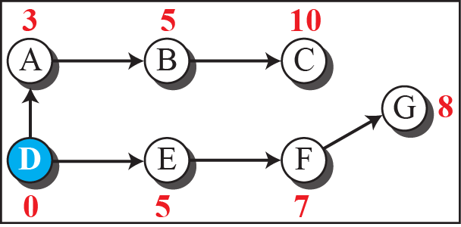
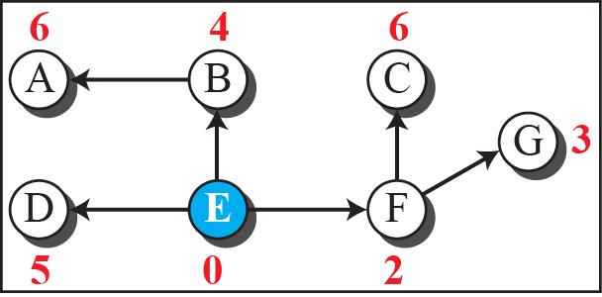
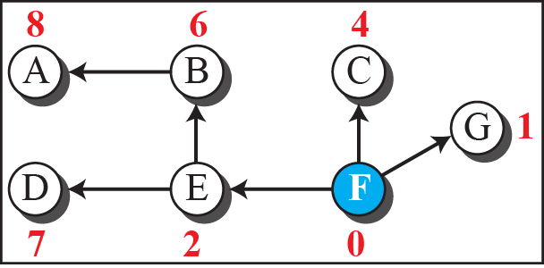
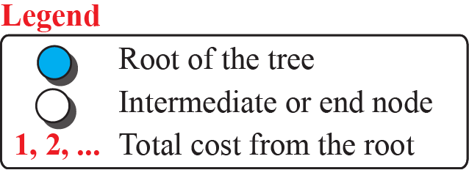
Introduction-Distance vector routing

Slide 8
Routing Algorithms (distance-vector routing)
In distance-vector routing, each router…
Creates a least-cost tree containing only connected networks
Exchanges its tree with each of its neighbours (other routers on connected networks)
Updates its own tree with the information from its neighbors
Repeat from Step 2 until no further information can be learned
Once complete, each router will have the same view of the network
Referred to as convergence, where all routers agree on the best paths
Agreement is critical otherwise packets could loop in the network, e.g., Router A thinks the best path to network X is through Router B Router B thinks the best path to network X is through Router A

Slide 9
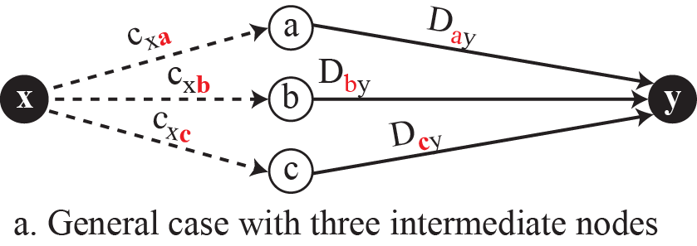
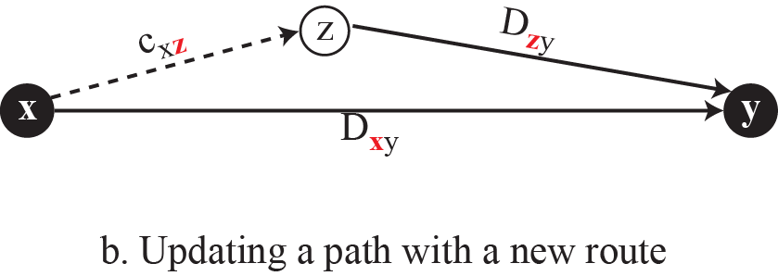
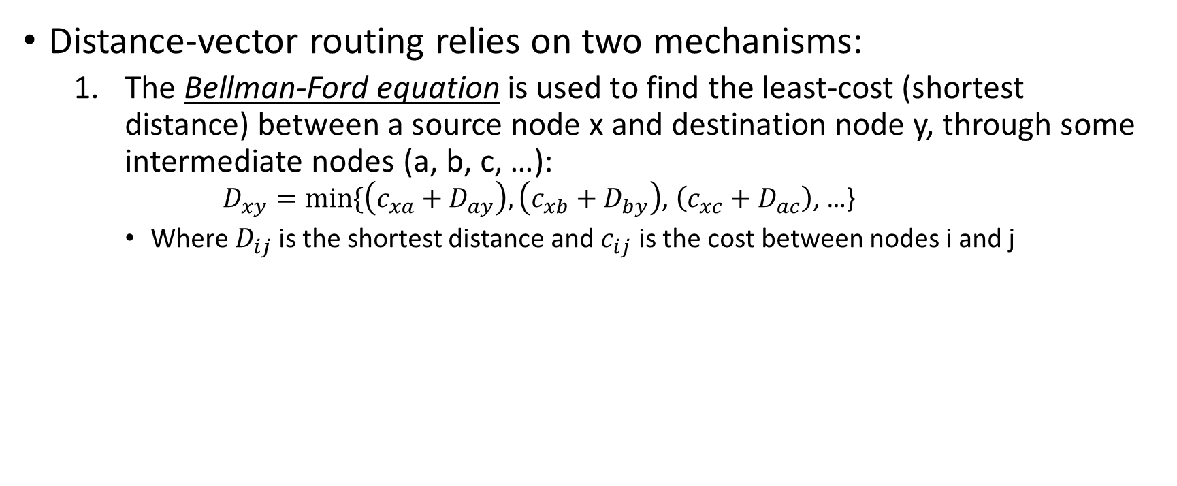
Routing Algorithms (Distance vector)
Distance-vector routing relies on two mechanisms:
The Bellman-Ford equation is used to find the least-cost (shortest distance) between a source node x and destination node y, through some intermediate nodes (a, b, c, …):
$$D_{xy}=min⁡\{\left(c_{xa}+D_{ay}\right),\left(c_{xb}+D_{by}\right)\text{, }\left(c_{xc}+D_{ac}\right)\text{, …\}}$$
Where $D_{ij}$ is the shortest distance and $c_{ij}$ is the cost between nodes i and j

Slide 10
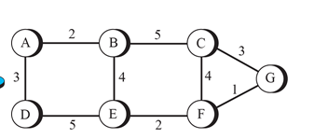
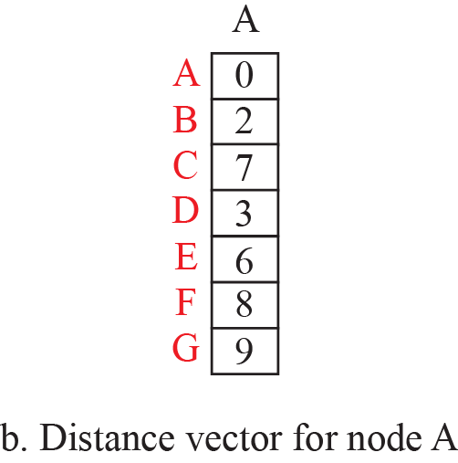
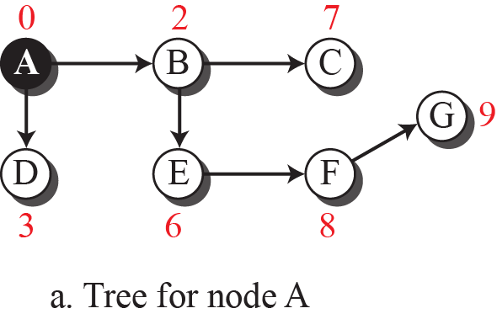
Routing Algorithms (Distance vector)
Distance-vector routing relies on two mechanisms:
The distance vector is an array which represents the known distances (not the paths) to remote networks from a particular source
7=Distance from A to C

Slide 11
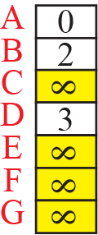
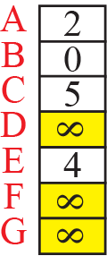
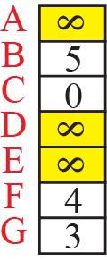
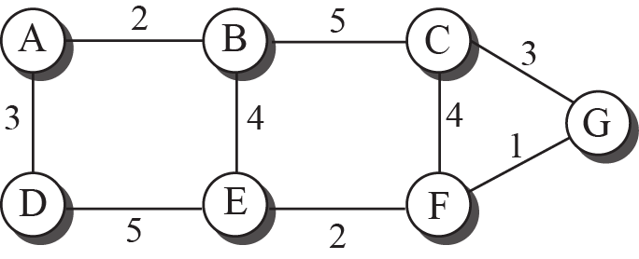
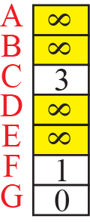
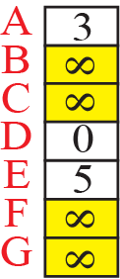
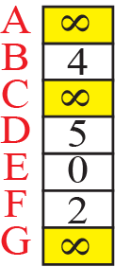
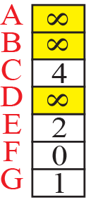
Routing Algorithms(Distance vector)
Distance vectors are initialised and exchanged as discussed before to construct of complete trees
Initial startup…
Initially, consider the nodes which are directly connected and take the distance.
Other distance, take as infinity

Slide 12
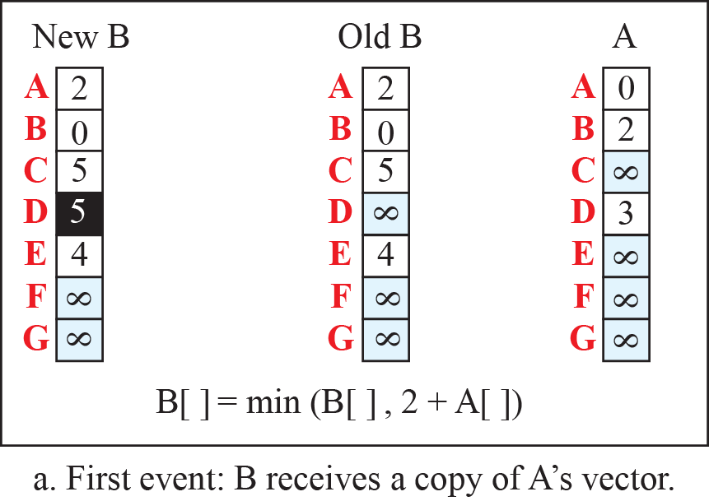
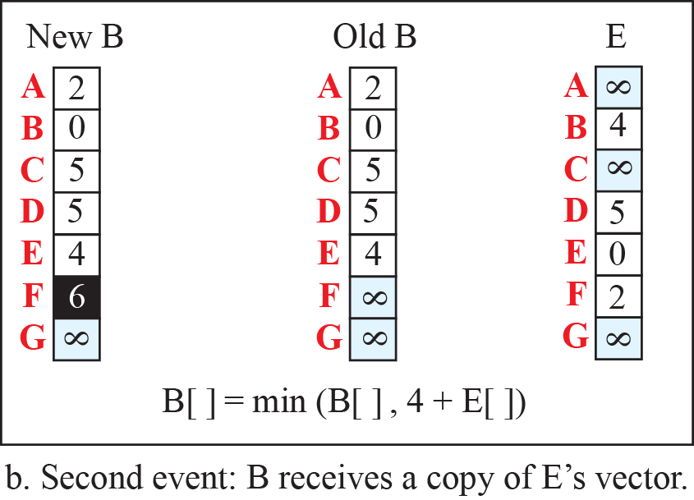
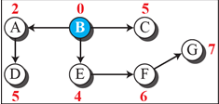
Routing Algorithms (Distance vector)
Distance vectors are initialised and exchanged as discussed before to construct of complete trees.
In figure a, B receives an update from A , then B updates its own table if it finds any distance to other nodes through A from B becomes less than its current value.
Let’s consider 1st row in figure a, we want to calculate distance to A from B through A.
Old B
2
This is from Old vector B ‘Old B’, it is already known to router B (1st row)
B
A
Update
process B
2
0
B
A
A
A at New B=Minimum(2, 2+0 ) = 2
From ‘Old B’, distance from B to A=2 , also in the tree right side
2= distance from B to A, first element in the vector old B
4= distance from B to E, the fifth element in the old vector old B

Slide 13
Routing Algorithms (Distance vector)
Distance vectors are initialised and exchanged as discussed before to construct of complete trees.
In figure a, B receives an update from A , then B updates its own table if it finds any distance to other nodes through A from B becomes less than its current value.
Let’s consider 2nd row in figure a, we want to calculate distance to B from B through A.
Old B
2
This is from Old vector B ‘Old B’, it is already known to router B (2nd row)
B
A
Update
process B
2
2
B
A
B
B at New B=Minimum(0, 2+2 ) = 0
From ‘Old B’, distance from B to A=2 , also in the tree right side
2= distance from B to A, first element in the vector old B
4= distance from B to E, the fifth element in the old vector old B

Slide 14
Routing Algorithms (Distance vector)
Distance vectors are initialised and exchanged as discussed before to construct of complete trees.
In figure a, B receives an update from A , then B updates its own table if it finds any distance to other nodes through A from B becomes less than its current value.
Let’s consider 3rd row in figure a, we want to calculate distance to C from B through A.
Old B
5
This is from Old vector B ‘Old B’, it is already known to router B (3rd row)
B
C
Update
process B
2
Infinity
B
A
C
C at New B=Minimum(2 + Infinity =Infinity, 5 ) = 5
From ‘Old B’, distance from B to A=2 , also in the tree right side
2= distance from B to A, first element in the vector old B
4= distance from B to E, the fifth element in the old vector old B

Slide 15
Routing Algorithms (Distance vector)
Distance vectors are initialised and exchanged as discussed before to construct of complete trees.
In figure a, B receives an update from A , then B updates its own table if it finds any distance to other nodes through A from B becomes less than its current value.
Let’s consider 4th row in figure a, we want to calculate distance to D from B through A.
Old B
B
Infinity
D
This is from Old vector B ‘Old B’, it is already known to router B (4th row)
Update
process B
2
3
B
A
D
D at New B=Minimum( Infinity , 2+3 = 5 ) = 5
From ‘Old B’, distance from B to A=2 , also in the tree right side
2= distance from B to A, first element in the vector old B
4= distance from B to E, the fifth element in the old vector old B

Slide 16
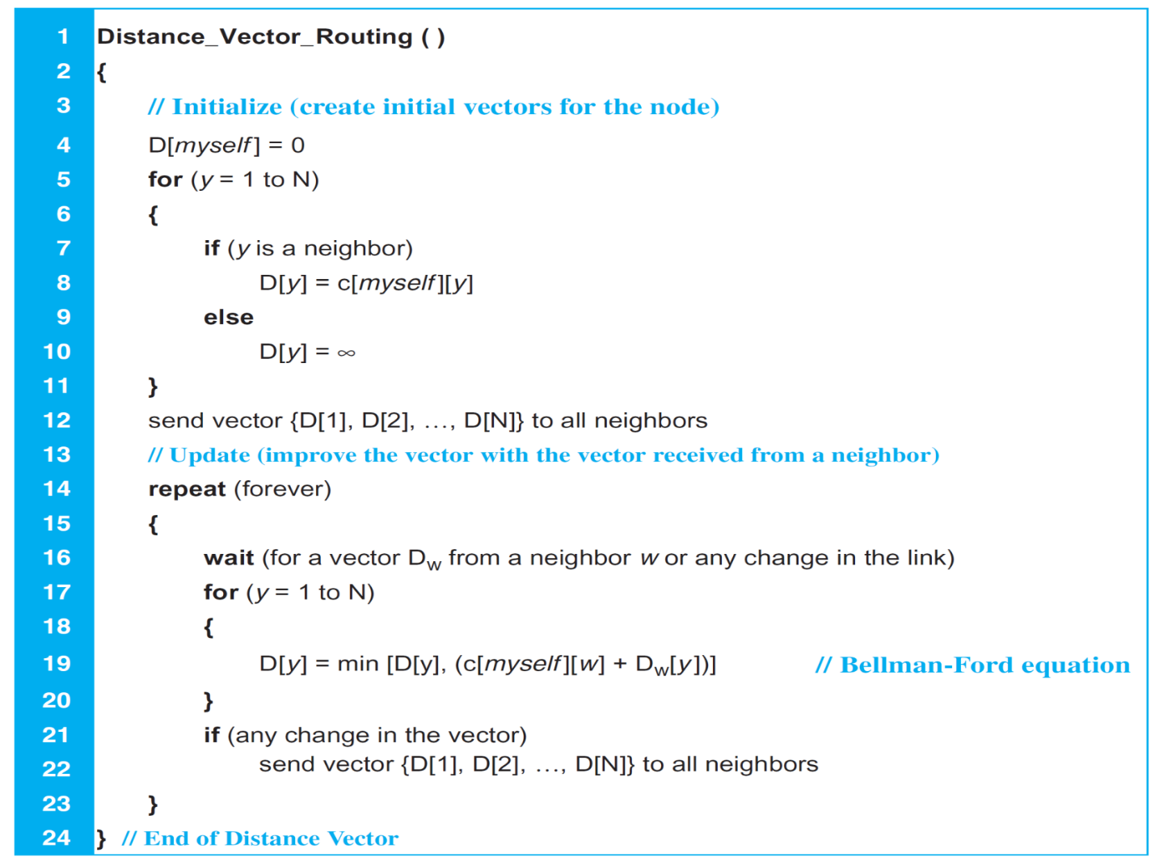
Routing Algorithms (Distance vector)

Slide 17
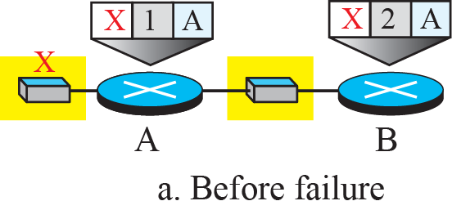
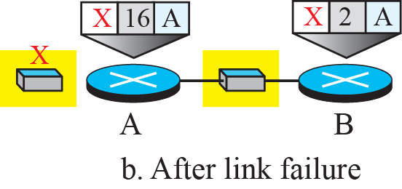
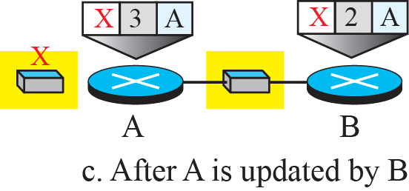
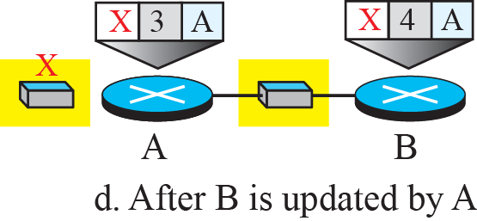
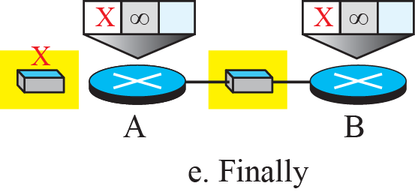
Routing Algorithms (Distance vector routing: problems)
Distance vector algorithm problems:
Count to Infinity:
At the beginning, both nodes A and B know how to reach node X. Assuming distance from node to node is unity, 16 is considered as maximum distance (as infinity).
But suddenly, the link between A and X fails. Node A changes its table in on A, Fig (b)
If A can send its table to B immediately, everything is fine.
However, the system becomes unstable if B sends its forwarding table to A before receiving A’s forwarding table.
Node A receives the update and, assuming that B has found a way to reach X, immediately updates its forwarding table in Fig (c)
Now A sends its new update to B. Now B thinks that something has been changed around A and updates its forwarding table in B in Fig (d).
The cost of reaching X increases gradually until it reaches infinity.
At this moment, both A and B know that X cannot be reached.
However, during this time the system is not stable.
Node A thinks that the route to X is via B; node B thinks that the route to X is via A. If A receives a packet destined for X, the packet goes to B and then comes back to A.
Similarly, if B receives a packet destined for X, it goes to A and comes back to B. Packets bounce between A and B, creating a two-node loop problem.

Slide 18
Routing Algorithms (Distance vector: solution of problems)
Distance vector algorithm problem solutions:
Split horizon:
One solution to instability caused by count-to-infinity / two-node loop
Only send partial distance vectors to other routers, does not send distances for nodes to their source
Example: if Router B thinks the best path to network X is via router A, don’t include the distance for X in updates sent to A
Poison reverse:
Using the split-horizon strategy has one drawback. Normally, the corresponding protocol uses a timer, and if there is no news about a route, the node deletes the route from its table.
When node B in the previous scenario eliminates the route to X from its advertisement to A, node A cannot guess whether this is due to the split-horizon strategy (the source of information was A) or because B has not received any news about X recently and route was deleted.
In the poison reverse strategy B can still advertise the value for X,
if Router B thinks the best path to network X is via Router A, set the distance to infinity when sending advertisement to Router A.
This flags the route and warns router A that do not update this route to X via A.

Slide 19
Routing Algorithms (Link-state algorithms )
Link-state algorithms are an alternative to distance vector algorithms
Instead of receiving a distance vector from the neighbour routers, receive information regarding the links in the network and their state
Each router sends link state information for connected networks using a process known as flooding
A router receiving link state information forwards it out all links except where it came from
No changes are permitted to the link state information, i.e., every router receives the state of all links from the routers connected to those links

Slide 20
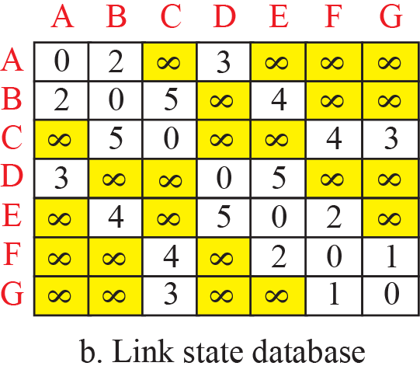
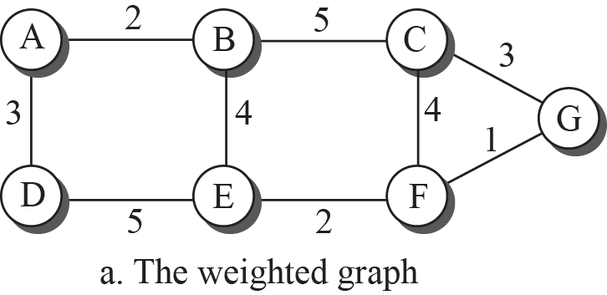
Routing Algorithms
Using this information, each node constructs its own copy of a complete map of the network
This map is in the form of the weighted graph we saw earlier
Referred to as the link-state database

Slide 21
Routing Algorithms
When the link state database (LSDB) is updated, a least-cost tree is constructed using Dijkstra’s Algorithm
Often referred to as shortest path algorithm
Basic steps:
The node chooses itself as the root of the tree, creating a tree with a single node and sets the total cost of each node based on the information in the LSDB.
The node selects one node, among all nodes not in the tree, which is closest to the root, and adds this to the tree. After this node is added to the tree, the cost of all other nodes not in the tree needs to be updated because the paths may have been changed.
The node repeats step 2 until all nodes are added to the tree.

Slide 22
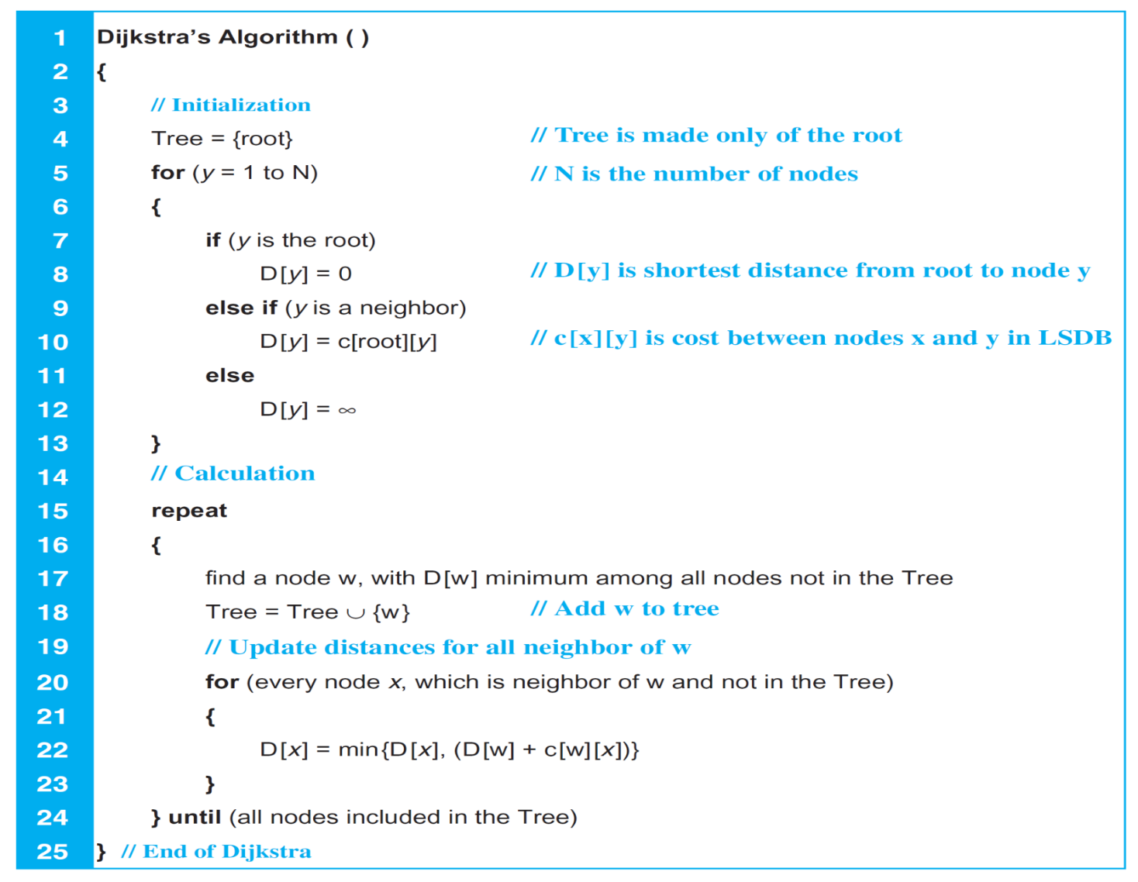
Routing Algorithms

Slide 23
Routing Algorithms
This may seem quite complex, but is quite simple
Start by selecting the root of the tree and record costs to connected nodes
A: ∞
B: ∞
C: G → C = 3
D: ∞
E: ∞
F: G → F = 1
G: G = 0
A
2
B
5
C
3
3
4
4
1
G
D
5
E
2
F

Slide 24
Routing Algorithms
This may seem quite complex, but is quite simple
The node with lowest cost (1) from root G to other nodes is F (earlier slide-23)
Add F to the tree
Only consider the paths that are directly connected to nodes in tree (G, F)
Directly not connected nodes, distance infinity
Lock in the lowest cost path that is not already known and check for lower cost paths to other destinations not locked in through that node
A: ∞
B: ∞
C: G → C = 3
D: ∞
E: G → F → E = 3
F: G → F = 1
G: G = 0
paths through G: to (nodes C,E,F:
GC,GF,GFE),
Lowest cost path GF
F is locked.
A
2
B
5
C
3
3
4
4
1
G
D
5
E
2
F

Slide 25
Routing Algorithms
This may seem quite complex, but is quite simple
Repeat until all nodes are locked in
Lowest cost from root G to other nodes is 3 with C or E (earlier slide-24)
Add any of C or E to the tree, here C is considered
Only consider nodes that are directly connected to nodes in tree (G,F,C)
Directly not connected nodes, distance infinity
Note in this case there are two equal low cost paths, lock in either
A: ∞
B: G → C → B = 8
C: G → C = 3
D: ∞
E: G → F → E = 3
F: G → F = 1
G: G = 0
paths through G, C,F, to B,E
: GC,GCB,GFE
GC and GFE are lowest=3
GC is selected and C is locked
A
2
B
5
C
3
3
4
4
1
G
D
5
E
2
F

Slide 26
Routing Algorithms
This may seem quite complex, but is quite simple
Repeat until all nodes are locked in
nodes in tree (G,F,C,E)
Alternative path to node B and D, higher cost
Alternative path to node B and D, lower cost, E locked
A: ∞
B: G → F → E → B = 7
C: G → C = 3
D: G → F → E → D = 8
E: G → F → E = 3
F: G → F = 1
G: G = 0
A: ∞
B: G → C → B = 8
C: G → C = 3
D: G → C → B → E → D = 14
E: G → F → E = 3
F: G → F = 1
G: G = 0
A
2
B
5
C
3
3
4
4
1
G
D
5
E
2
F

Slide 27
Routing Algorithms
This may seem quite complex, but is quite simple
Repeat until all nodes are locked in
nodes in tree (G,F,C,E,B)
A: G → F → E → B → A = 9
B: G → F → E → B = 7
C: G → C = 3
D: G → F → E → D = 8
E: G → F → E = 3
F: G → F = 1
G: G = 0
A
2
B
5
C
3
3
4
4
1
G
D
5
E
2
F

Slide 28
Routing Algorithms
This may seem quite complex, but is quite simple
Repeat until all nodes are locked in
A: G → F → E → B → A = 9
B: G → F → E → B = 7
C: G → C = 3
D: G → F → E → D = 8
E: G → F → E = 3
F: G → F = 1
G: G = 0
A
2
B
5
C
3
3
4
4
1
G
D
5
E
2
F

Slide 29
Routing Algorithms
This may seem quite complex, but is quite simple
Repeat until all nodes are locked in
A: G → F → E → B → A = 9
B: G → F → E → B = 7
C: G → C = 3
D: G → F → E → D = 8
E: G → F → E = 3
F: G → F = 1
G: G = 0
A
2
B
5
C
3
3
4
4
1
G
D
5
E
2
F

Slide 30
Unicast Routing Protocols
Unicast routing protocols are based on the distance-vector and link-state algorithms, but also define:
Their domain of operation;
The messages exchanged;
Communication between routers; and
Interaction with protocols in other domains.
Three common routing protocols:
Routing Information Protocol (RIP): a vector-distance protocol
Open Shortest Path First (OSPF): a link-state protocol
Border Gateway Protocol (BGP): a path-vector protocol

Slide 31
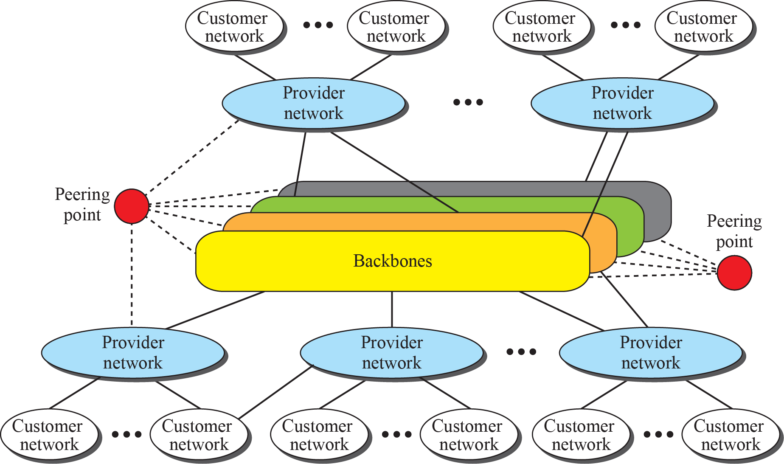
Unicast Routing Protocols
Over time the Internet moved from tree-like structure with a single backbone to a multi-backbone structure
Different backbones by multiple corporations providing global connectivity
Peering points provide connectivity between backbones
Provider networks use global connectivity of backbones to provide services to customers
Customer networks use services of provider networks
Any/all can be considered ISPs, providing services at different levels

Slide 32
Unicast Routing Protocols
Given the huge number of networks it is not possible to use a single routing protocol
Scalability – the size of the forwarding tables would be too big / huge
Administrative issue – each organisation must be able to control/design/run its own network
Hierarchical routing is used instead:
Each ISP is considered an autonomous system (AS)
Each AS run its own routing protocol (of its choice), e.g., RIP or OSPF
Referred to as an intra-AS / intra-domain / Interior Gateway Protocol (IGP)
A single global protocol is then used to “glue” the ASs together (BGP)
Referred to as an inter-AS / inter-domain / Exterior Gateway Protocol (EGP)

Slide 33
Unicast Routing Protocols
Each AS is allocated an Autonomous System Number (ASN) by Internet Corporation for Assigned Names and Numbers (ICANN) and classified according to their relationship with other ASs
Stub AS
Has only one connection to another AS
Traffic either initiates or terminates in a stub AS
Multihomed AS
Similar to a stub AS but has more than one connection to another AS
Common in large customer networks which will have at least two connections to the Internet for reliability
Transient AS
Connected to more than one AS but also allows traffic not initiated/terminating in the AS to pass through it
Provider networks and backbone networks are example transient ASs

Slide 34
Unicast Routing Protocols
Routing Information Protocol (RIP)
Based on distance-vector algorithm
Uses hop count to measure cost
Very simple, but also very limited – does not consider delay, bandwidth, etc.
Makes poor choices in heterogeneous networks
e.g., a path of one 100Mbps link will be used in preference to a path consisting of two 10Gbps links
Uses a four bit integer to represent hop count / cost, i.e., 0-15
Implies that a value of 16 is infinity, therefore the maximum hop count within the AS must be 15 or less (referred to as the diameter of the network)

Slide 35
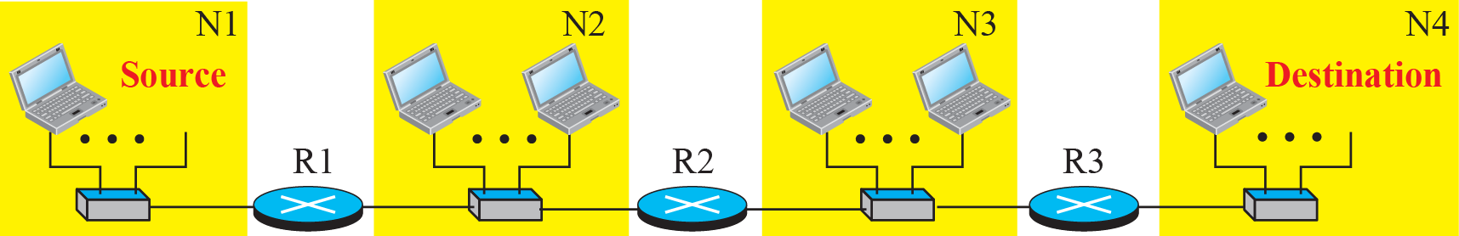
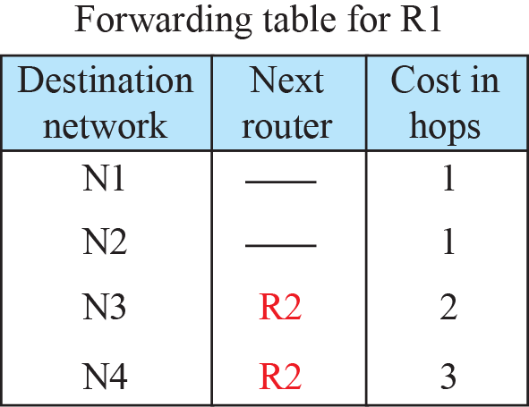
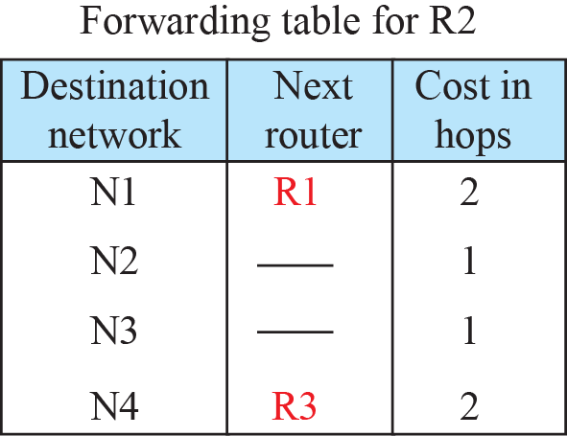
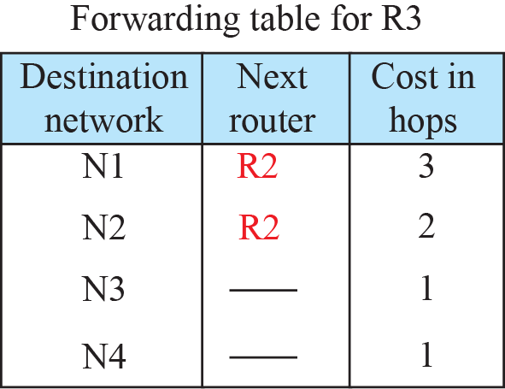
Unicast Routing Protocols
RIP is responsible for maintaining the router’s forwarding tables, consisting of:
Destination network address
Address of the next router in the path
This tells the router which link to send a packet on as both the current and next router must be connected via a common link
Number of hops to the destination network
Required when an update is received from another router

Slide 36
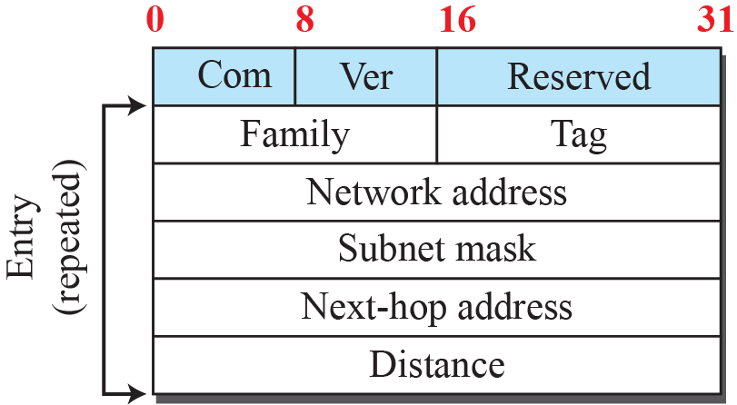
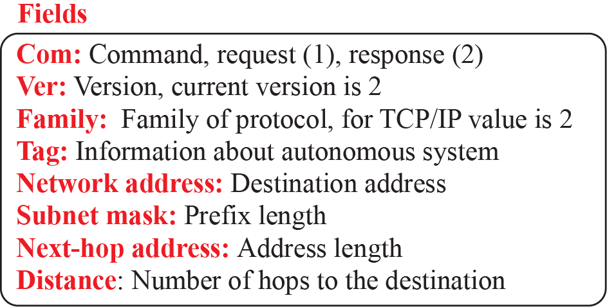
Unicast Routing Protocols
There are three versions of RIP:
For IPv4: RIPv1 classful, do not send subnetmask, later replaced by RIPv2 which supports classless addressing
For IPv6: RIPng
RIP message format:

Slide 37
Unicast Routing Protocols
RIP implements the vector-distance algorithm as discussed, with the following changes:
Router sends whole forwarding table, not just distance vectors
Upon receiving an update, a router:
Increases the hop count by one
Changes the next-hop address of the source router
Compares the entries in the modified update with the forwarding table
If an update entry does not exist in the forwarding table, it is added
If the hop count is less than the route in the forwarding table, it is replaced
If the hop count is greater than the route in the forwarding table, but the next-hop address matches, the entry is updated

Slide 38
Unicast Routing Protocols
RIP timers:
A router with RIP enabled will send out updates every 25-35 seconds
Actual timer is randomly set each time to prevent routers being overloaded with RIP updates
Each route in the forwarding table is assigned a timeout of 180 seconds
Each time an update is received with a matching route, the timer is reset
If the timer expires, the hop-count is set to 16 (infinity)
The router will continue to include the route in its updates, with the infinite hop-count
The route will be removed by a garbage collection mechanism 120 seconds later

Slide 39
Unicast Routing Protocols
RIP performance:
Update messages
As discussed, random timers avoid (“prevent”) updates becoming a problem
Convergence of forwarding tables
As for distance-vector algorithm
Can converge slowly for large domains, i.e., many networks/possible routes
Somewhat restricted by the maximum hop-count of 15
Count-to-infinity and loops can contribute to slow convergence
Use of poison-reverse and split-horizon can alleviate the problem
Robustness
Each router relies on the information given to it by neighbour routers
A failure/corruption in one router’s forwarding table will propagate to all other routers

Slide 40
Unicast Routing Protocols
Open Shortest Path First (OSPF)
An intra-domain routing protocol like RIP, however using link-state algorithm
Metric can be based on
Throughput
Round-trip time
Reliability
Hop-count
Forwarding tables are calculated using Dijkstra’s algorithm, as discussed earlier

Slide 41
Unicast Routing Protocols
OSPF can be used as a routing protocol for the whole AS, as for RIP
If hop-count is used for the metric, the forwarding tables will be identical to RIP, with the following differences…
Advantage: Convergence is much quicker as routers build their own picture of the network based on link state information rather than using other routers knowledge
Disadvantage: OSPF has higher overheads, both in computation (Dijkstra calculations) and communication (link state updates for every link in the network)
Using a different metric can result in better traffic routing also
Hop count is rarely used / not used

Slide 42
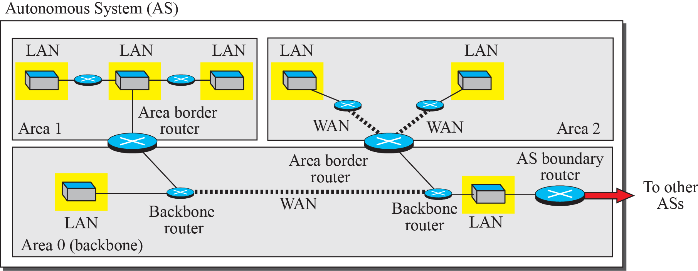
Unicast Routing Protocols
OSPF introduces the concept of areas
An AS can be divided into several areas
One area (the 0th area) connects the other areas together
Each area runs OSPF with a scope of the networks within that area
Summary addresses (route summarization) usually used to reduce the size of routing tables outside of an area
The use of areas minimises the overheads of OSPF in larger ASs
Dijkstra’s algorithm only needs to consider a smaller subset of the network
Link-state updates only forwarded within the area, not the whole AS

Slide 43
Unicast Routing Protocols
OSPF performance:
Update messages
Link-State Advertisements(LSA), are flooded through the entire area and can create heavy traffic for large areas
Convergence of forwarding tables
After LSA flooding each router creates its own shortest-path tree and is fairly quick
Robustness
Each router is independent and does not rely on other routers
Corruption or failure in one router does not affect other routers as seriously

Slide 44
Review Questions from Network layer Try to understand these questions (sample questions)
Explain the metrics of network layer performances
Describe the three phases of virtual circuit approach to switching
Explain address aggregation and its importance,
Explain the Longest mask principle and how it affects in packet forwarding at router.
What are the different components of forwarding table of a router and how packets are forwarded when they arrive at router?
Explain the fact if longest mask principle is not followed
Explain NAT and how does it overcome the address space problem of IPv4
Explain different types of translation techniques used in NAT
Explain how NAT overload (PAT) eliminates IP address pooling at NAT router

Slide 45
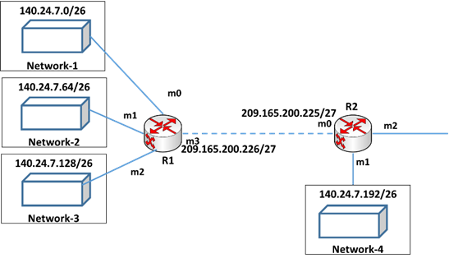
Review Questions from Network layer Try to understand these questions (sample questions)
In the following network, router R1 is connected with three networks with interfaces (m0, m1 and m2). Router R2 is connected with router R1, but it is far from R1. Corresponding interfaces of routers are mentioned in the following diagram. The IP addresses of networks are mentioned in the diagram.
A) Correctly write the forwarding tables of both routers R1 and R2. Your forwarding tables should have the columns: Network address/mask, next hop address and interfaces. R2 must include aggregated address in the forwarding table.
B) If a packet with destination address 140.24.7.200 arrives at router R1 from any networks (network-1, 2, or 3), mention the interface name of router R1 to which the packet will be delivered and explain your answer using the forwarding table of R1 in (A).
C) Assume a packet arrives at router R2 with destination address 140.24.7.200. Explain how router R2 forwards this packet to the destination using your forwarding table in (A).

Slide 46
Chapter 22
Next Generation IP

Slide 47
IPv6 Addressing
As discussed before, IPv4 is running out of addresses
Consider that IPv4 uses a 32-bit address (4,294,967,296 possible addresses)
If it was a 33 bit address, we would have double the number of addresses
If it was a 34 bit address, we would have four times the number of addresses
…
IPv6 uses a 128-bit address (340,282,366,920,938,463,463,374,607,431,768,211,456 addresses)
Double the number of IPv4 addresses, and keep going, until you have doubled the number of addresses 96 times!
So just how big is this?
If you distributed IP addresses equally across the earth’s surface, per square meter there will be approximately 667,000,000,000,000,000,000,000 IPv6 addresses

Slide 48
IPv6 Addressing
Like IPv4 addresses, IPv6 addresses are not written in binary
IPv4 addresses use 8-bit decimal numbers (0-255) separated by full-stops
IPv6 addresses use 16-bit hexadecimal numbers (0-FFFF) separated by colons
Example IPv6 address:
1234:5678:90AB:CDEF:1234:5678:90AB:CDEF
IPv6 addresses often have long sequences of zeroes, so it is possible to abbreviate a single sequence of 0s using two colons, e.g.,
1234:0:0:0:0:0:0:1 → 1234::1
1234:0:0:0:1:0:0:2 → 1234::1:0:0:2 OR 1234:0:0:0:1::2
Note that you can’t abbreviate both sequences of 0s, e.g., 1234::1::2 is invalid
Subnet masks are also relevant to IPv6, however only CIDR notation is used, e.g., FE80::1/64

Slide 49
IPv6 Addressing
IPv6 also defines three types of addresses:
Unicast addresses, as discussed in earlier weeks
Sent to a single device/host
Multicast addresses, as discussed in earlier weeks
Sent to multiple devices/hosts
Broadcast addresses, as discussed in earlier weeks, are a special case of multicast
Anycast addresses – these are new!
Defines a group of hosts that share an address
A packet with an anycast address for the destination will be delivered to only one host of the group

Slide 50
IPv6 Addressing
As for IPv4, parts of the IPv6 address space are allocated for different purposes:
This accounts for less than 15% of the total address space!
Like IPv4, the global unicast pool is gradually being allocated to organisations and individuals
All IPv6 addresses starting with binary 001 are global unicast addresses, so 2¹²⁵ addresses are available for allocation!
If these addresses run out (unlikely for a very long time), further allocations can be made

Slide 51
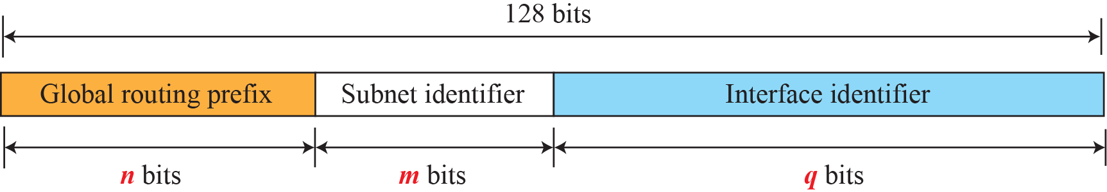
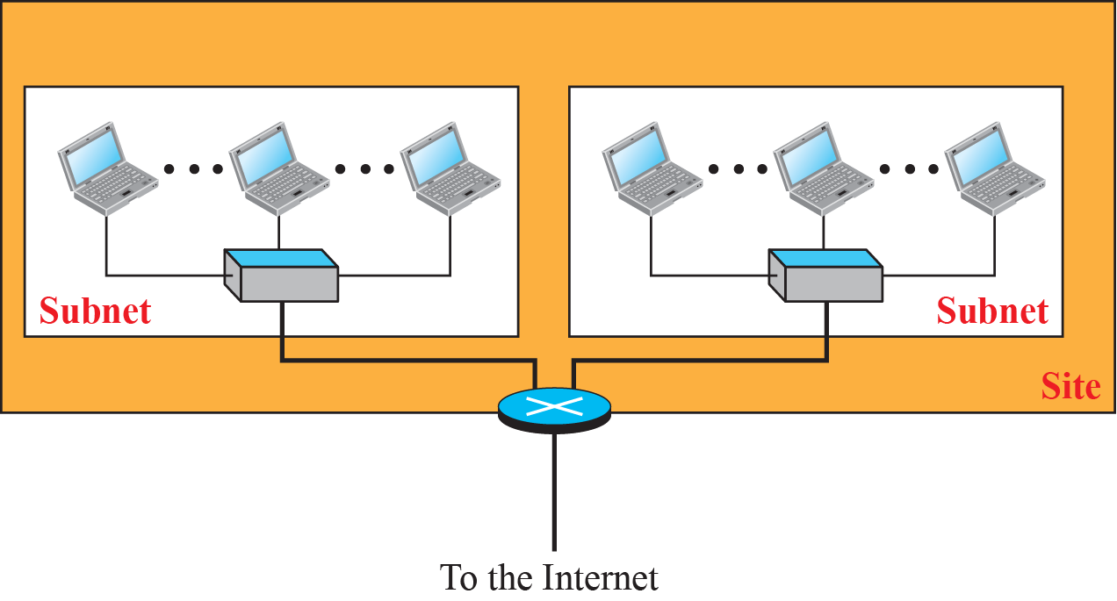
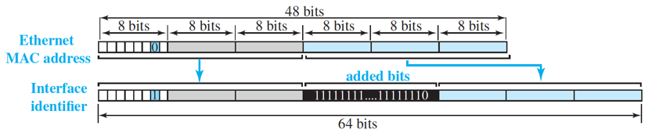
IPv6 Addressing(Global unicast address )
The global unicast address is usually divided according to the following pattern:
The interface identifier is mapped using
Extended Unique Identifier (EUI)-64
For an Ethernet address, the value 0xFFFE (1111111111111110) is is inserted into the middle of the MAC address
Map local to global (0 to 1)
n=48, m=16, q=64,
3 bit reserved (001),
48-3=45, 2⁴⁵= private organization

Slide 52
Figure 22.2: Mapping for EUI-64

Slide 53
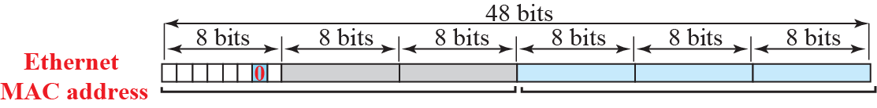


Figure 22.3: Mapping for Ethernet MAC
the value 0xFFFE (1111111111111110)
The hex value FFFE = (1111111111111110)

Slide 54
Example 22.3
Using the format defined for Ethernet addresses, find the interface identifier if the Ethernet physical address is (F5-A9-23-14-7A-D2)₁₆. 4 bit each hex number, total 4x12=48 bit mac address.
Solution
At first determine first two octets from the left.
Consider each 4 bit as a group, first (4 bit from left): 1111=F
Second (4 bit) 0101=5, Then first 8-bit=11110101.
We only need to change the seventh bit of the first octet from 0 to 1,
change 2nd bit from right to 1. this will be 0111=7,
The octet result is =11110111.
so first octet in new EUI address: F7
Insert two octets FFFE₁₆ and change the format to colon hex notation. The result is F7A9:23FF:FE14:7AD2 in colon hex.
22.54

Slide 55

Example 22.1
An organization is assigned the block 2000:1456:2474/48. What is the CIDR notation for the blocks in the first and second subnets in this organization?
Solution
Here 2000:1456:2474=Global prefix, defines the site, hex number, each hex number 4 bit, 4x12=48 bit global prefix.
Theoretically, the first and second subnets should use the blocks with subnet identifiers 0001_{16(m bit)} and 0002_{16(m bit)}.
This means that the blocks are 2000:1456:2474:0001/64 and 2000:1456:2474:0002/64 (m+n=64).
n=48=site, global prefix, m=16=subnet, q=64=interface
identifier
22.55

Slide 56

Example 22.4
An organization is assigned the block 2000:1456:2474/48. What is the IPv6 address of an interface in the third subnet if the IEEE physical address of the computer is
(F5-A9-23-14-7A-D2)₁₆?
Solution
From example 22.3, interface identifier of (F5-A9-23-14-7A-D2)₁₆ =F7A9:23FF:FE14:7AD2
The interface identifier for this interface is F7A9:23FF:FE14:7AD2 (see Example 22.3). If we append this identifier to the global prefix and the subnet identifier, we get:
22.56

Slide 57
IPv6 Addressing
Several special addresses are defined, as follows:
Unspecified – using during boot when a host doesn’t know its address
Loopback – same as IPv4 (127.0.0.1), written simply as ::1!
Compatible – IPv4 compatible IPv6 address (deprecated/no longer used)
Mapped – used by an IPv6 host to send a message to an IPv4 host

Slide 58
IPv6 Addressing
Autoconfiguration of hosts:
In IPv4 hosts and routers were originally configured manually
Later supplemented by DHCP
In IPv6, DHCP can still be used (“DHCPv6”), however hosts can also configure themselves
Host generates a link-local address (scoped to the link)
Interface ID as discussed previously
Host confirms link-local address is unique using a neighbour solicitation message
Any other host using that link-local address will return neighbour advertisement message
If unique, host then contacts the local router using a router solicitation message
Router responds with router advertisement message providing global unicast and subnet prefixes
Host configures its own global unicast IPv6 address as discussed previously

Slide 59


Example 22.5
Assume a host with Ethernet address
(F5-A9-23-11-9B-E2)¹⁶
has joined the network. What would be its global unicast address if the global unicast prefix of the organization is
3A21:1216:2165 and the subnet identifier is A245:1232?
Solution
The host first creates its interface identifier as F7A9:23FF:FE11:9BE2 using the Ethernet address read from its card. The host then creates its link local address as:
Assuming that this address is unique, the host sends a router solicitation message and receives the router advertisement message that announces the combination of global unicast prefix and the subnet identifier as 3A21:1216:2165:A245:1232. The host then appends its interface identifier to this prefix to find and store its global unicast address as:
22.59

Slide 60
The IPv6 Protocol
Given that the change in IP address was necessary, this also allowed other changes to be made to the IP header:
Better header format
Options field is separated from the IP header (IPv6 header is now fixed length)
Fragmentation and reassembly no longer possible at intermediate routers
Speeds up processing by routers
New options
New options for additional functionality
Allowance for extension
Designed to allow for extensions for new technologies and applications
Support for resource allocation
IPv4 Type of Service field replaced with traffic class and flow labels to allow a host to request special handling of the packet (Quality of Service)
Support for more security
Encryption and authentication options for confidentiality and integrity of packets (based on IPsec)

Slide 61


The IPv6 Protocol

Slide 62
The IPv6 Protocol
IPv6 Extension Headers:
Hop-by-Hop – used to pass information to routers in the path to destination
Pad1/PadN – used for padding to ensure options start at a certain bit (byte alignment)
Jumbo payload – allows for payloads greater than 65,535 bytes
Destination – used to pass information to the destination
Pad1/PadN – as for hop-by-hop
Source routing
Similar to IPv4 source routing
Fragmentation
Similar to IPv4 fragmentation but only the source/sender can do the fragmentation
Source must use a Path MTU Discovery technique to find the smallest MTU in the path
Authentication and ESP
Security based on IPsec (discussed later)

Slide 63
The ICMPv6 Protocol
ICMPv6 is an updates ICMPv4 for IPv6
Follows same strategy and purpose
Some other protocol functionality now included, e.g., ARP and IGMP
Four groups of messages:
Error messages – destination unreachable, packet too big, time exceeded, parameter problem
Informational messages – echo request and reply
Neighbor Discovery (ND) messages – includes ARP functionality and defines neighbor discovery/advertisement and router discovery/advertisement messages
Group Membership messages – includes IGMP functionality

Slide 64
Transition from IPv4 to IPv6
The biggest problem faced by IPv6 is deployment
There is already a huge investment in IPv4 capable equipment, some of which is not IPv6 capable
Where is the motivation?
If an organisation / individual is able to use the Internet successfully, why do they care?

Slide 65



Transition from IPv4 to IPv6
Strategy 1: Dual Stack
Each host / intermediate device uses both IPv4 and IPv6 simultaneously
Once the entire Internet is IPv6 capable, IPv4 can be dropped/disabled

Slide 66



Transition from IPv4 to IPv6
Strategy 2: Tunnelling
When traffic between IPv6 hosts/devices must pass over an IPv4-only network, traffic can be temporarily encapsulated in IPv4 datagrams
Note: both end-points are IPv6, only intermediate network/s is/are IPv4

Slide 67



Transition from IPv4 to IPv6
Strategy 3: Header translation
Where traffic is being sent from a IPv6 host/device to an IPv4-only host/device
Tunnelling doesn’t work because receiver has no ability to read the IPv6 datagram

Slide 68
Review Question: Multiple choice question
The process of adding a header and/or trailer to a payload is known as
1) Encapsulating
2) Enveloping
3) Packaging
4) Packetizing
5) Segmenting
100.0% | 1)
0.0% | 2)
0.0% | 3)
0.0% | 4)
0.0% | 5)

Slide 69
Review Question: Multiple choice question
When a PDU passes through an internetwork, which of the following devices will modify some of the information in the header?
1) Hub
2) Router
3) Switch
4) (b) and (c)
5) None of the above
Feedback
0.0% 1)
100.0% 2)
0.0% 3)
0.0% 4)
0.0% 5)

Slide 70
Review Question: Multiple choice question
The IP checksum is used to check the data integrity of
1) The destination address
2) The header
3) The payload
4) All of the above
5) None of the above
Answer
1)
2)
3)
4)
5)

Slide 71
Review Question: Multiple choice question
What is the name of the task of finding the "best" path between two hosts?
1) Forwarding
2) Roaming
3) Routing
4) Switching
5) Transmitting
Answer
1)
2)
3)
4)
5)

Slide 72
Review Question: Multiple choice question
In mobile IP, the temporary address is known as the
1) Care-of address
2) Home address
3) Mobile address
4) Origin address
5) Remote address
Answer
1)
2)
3)
4)
5)

Slide 73
Review Question: Multiple choice question
Which of the following protocols implements a distance vector algorithm?
1) Border Gateway Protocol
2) Open Shortest Path First
3) Routing Information Protocol
4) None of the above
Answer
1)
2)
3)
4)

Slide 74
Summary
Chapter 20. Unicast Routing
Introduction
Routing Algorithms
Unicast Routing Protocols
Chapter 22. Next Generation IP
IPv6 Addressing
The IPv6 Protocol
The ICMPv6 Protocol
Transition from IPv4 to IPv6

